Slide 1
Team IceFyre
Пикантно Жълт Вестник

Slide 2
Teamwork 2 – HTML & CSS
ORGANIZATION.
IDEAs.
PLANNING.
IMPLEMENTATION.

Slide 3



ORGANIZATION

Slide 4
Organization
Got in touch via E-Mail to exchange skype names.
Exchanged ideas in skype.
Set up Trello.
Set up Github.
Later met in person to discuss what to do.
Had numerous skype calls.

Slide 5


IDEAs

Slide 6
Considering ideas.
Initial draught of ideas.
Shy away from extreme ideas.
Shy away from complicated ideas.
Design drafts uploaded to trello.
Brainstormed when we met in person.
No really good ideas.
During second meeting decide to do a Yellow Paper-type of deal.

Slide 7
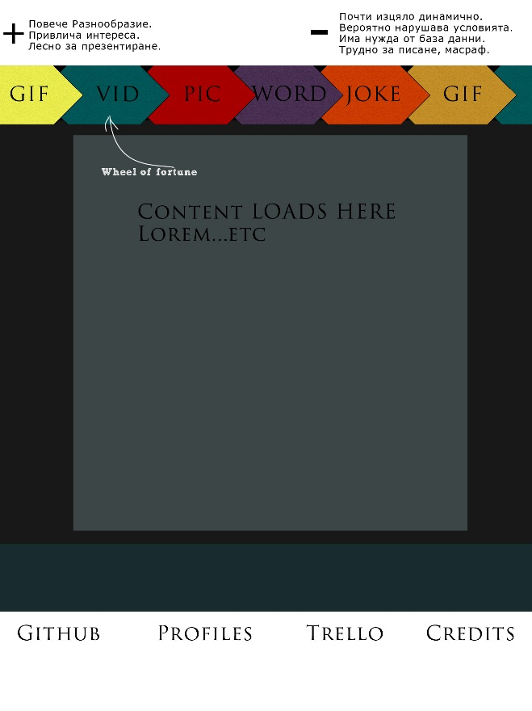
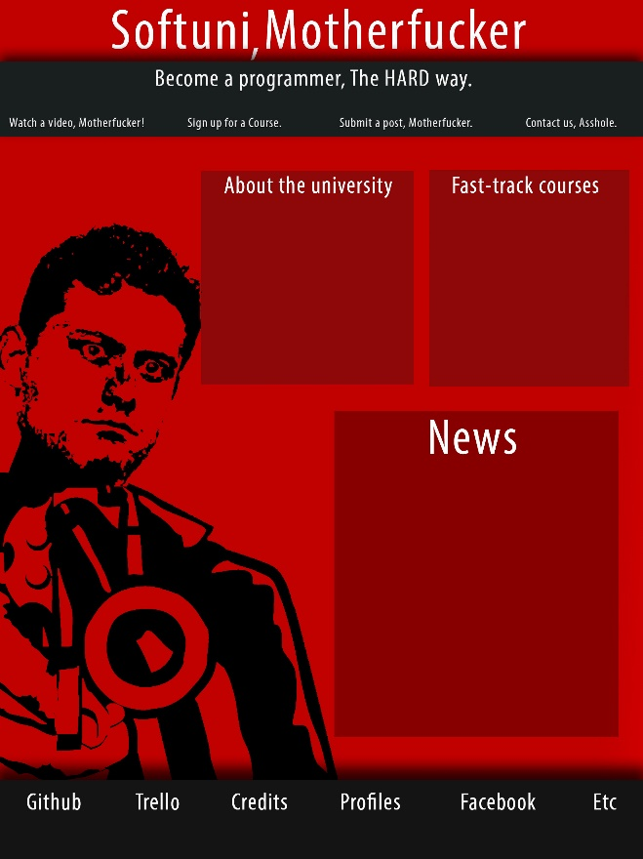
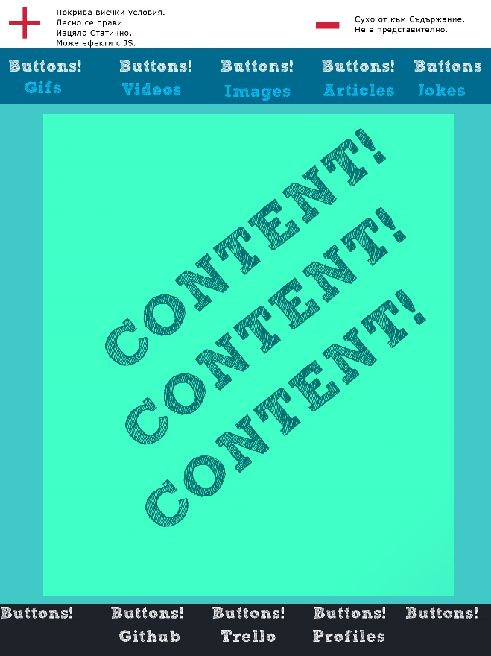
Design Drafts.
Multiple ideas about different sites. Design Drafts.

Slide 8
Yellow Paper
Final decision to do Yellow Paper, about 2 weeks before deadline.
Hot Headlines.
Broke the ice in terms of confidence.

Slide 9
PLANNING

Slide 10
Work Distribution
Distributed ourselves so each can do a part of the job:
Yavor – Coding.
Mina – Articles.
Asen – Design.
Nikolay – Responsiveness.

Slide 11


IMPLEMENTATION

Slide 12
Workflow
Design is drafted in Photoshop
From Photoshop it’s made into HTML / CSS
From there, It’s committed to github.
After that everyone can help edit the page.
Finally, when it’s done, the page is made responsive and is then recommitted.

Slide 13
Website
5 Pages Total.
Header.
Body, Articles.
Footer.
Responsiveness.
Semantic HTML.

